Slide 1

Concrete advice for working with youngsters who have lost any interest in school matters (intractable youngsters)

Slide 2
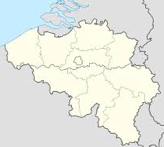
Belgium
Notes:
Brussel
Geel (yellow)

Slide 3
Brussels - Foyer

Slide 4
Foyer - Molenbeek
Molenbeek
Foyer is a pluralistic organisation with respect for diversity
Organisation is public not private
‘Free’ choice but also obliged to go to school
Practically oriented
Replaces regular education
No strict control but they have to move up to a regular school or to work, so they have to get a certain level
Engaged in:
Diversity
Interculturality
Global problems of the integration of immigrant populations
Notes:
De vzw Foyer werd in 1969 opgericht. De vereniging is in Molenbeek gehuisvest en houdt zich op het gemeentelijke, regionale en internationale vlak bezig met diversiteit, interculturaliteit en de globale problematiek van de integratie van allochtone bevolkingsgroepen.

Slide 5
Education center
The mission:
Realizing a full-time commitment of all the young people whom, for various reasons, do not find a connection within the mainstream education.
Notes:
The mission is to realize a full-time commitment of all the young people whom, for various reasons, do not find a connection within the mainstream education.
Onze missie is het voltijds engagement realiseren voor alle jongeren die, om uiteenlopende redenen, geen aansluiting vinden binnen het regulier onderwijs.

Slide 6
What?
Personal development trajectories for young people
To replace the ‘regular’ part-time education
Personal approach, education and work experience
→ Stimulates a positive evolution
Notes:
They offer a Personal development trajectories for young people
To replace the ‘regular’ part-time education aimed at young people between the ages of 15 and 18 who are no longer able to function in a normal school environment
The Training center utilizes a personal approach, education and work experience
→ Stimulates a positive evolution and offers young people the opportunity to develop their own talents
Het Vormingscentrum organiseert Persoonlijke Ontwikkelingstrajecten voor jongeren. Een POT is een globaal traject op maat van de jongere, ter vervanging van het “gewone” deeltijds onderwijs, gericht op jongeren tussen 15 en 18 jaar die niet meer (of ‘nog niet’) binnen een normaal schoolgebeuren kunnen functioneren -
Binnen het Vormingscentrum wordt een combinatie toegepast van een persoonlijke aanpak, vorming en arbeidservaring. Deze stimuleert een positieve evolutie en biedt de jongeren de kans om hun eigen talenten verder te ontplooien.

Slide 7
Personal Development Process
Youth 15-18 years
Not participate in the mainstream education
  Not the capacity to participate in a work- focused program because social/personal problems
  Multi complex problems and social vulnerability → need safe and protected environement
Coach
Notes:
Before I start, I have to say sorry for my bad English, I hope that you can understand me.
PPt 9: Personal Development Process
A Personal Development Process is a process for youth from fifteen to eighteen years old.
They are young people who cannot participate in the mainstream education.
They are young people who have not the capacity to participate in a work focused program, because of their personal or social problems.
Through their mostly multi complex problems and their social vulnerability, these young people need a safe and protected learning environment.
In the whole process the younger has a coach.

Slide 8
Personal Development Process
Not labour oriented but focused on quality
Training skills
Working en learning
Notes:
Ppt10: Personal Development Process
The process is not labor oriented but focused on quality. The main goal is: working on a qualitative return to school.
They work on their skills by working and learning in the foyer centrum

Slide 9
Which attitude do you take as coach?
Create a relationship of trust
Believe in the potential of the younger
Creating a positive environment
Give the opportunity to do new things
Give the younger responsibility
Safety and structure
Notes:
Ppt 11: Which attitude do you take as coach?
Which attitude do you take as coach?
Create a relationship of trust
Believe in the potential of the younger
Create a positive environment
Give the younger opportunities
Give the younger responsibility
Safety and structure
Now we go explain all of this.

Slide 10
Create a relationship of trust
Win the confidence of the younger
  The trust in society will grow
  Be serious about their story and reference
  Difference between girls and boys
  Keep a good balance between distance and proximity
  Reaction to the harrowing stories of the younger
    Detached
    Concerned
Notes:
Ppt 12: Create a relationship of trust
It is very important to win the trust of the younger.
There is a positive relationship developed with the younger and you as his or her coach. The younger becomes motivated by working on the process and coming to the centrum. At this way the trust in the society will grow.
It is also very important to take the younger serious, be serious about their story and reference. Respect the younger.
Trust is different between girls and boys → so with girls you develop trust to speak with them, with boys you develop trust by doing activities together.
It is also very important to keep a good balance between distance and proximity
The stories of the young people are sometimes very hard, and then you can react at two ways.
You as coach can be very detached from the younger. This gives that you are going to deny or minimize parts of his story. And so you blame the younger for his/her situation.
You can also get concerned. So you got caught up in the story of the younger and you identify too strongly with him or her.
On the other hand, To prevent that the connection between the coach and the younger is not to attached, a good balance between distance and proximity is needed to avoid that younger becomes in a loyalty conflict.
You can take as a coach the different roles of the parent (affective, responsible, and knowledgeable). And makes this clear to the younger and the parents and get the agreement of the parents to take over some pieces of these roles, with an attitude of professional proximity.

Slide 11
Believe in the potential of the younger
Identify what is good
Play to their strengths
Provide opportunities to do new things
  Develop talents
  Develop competences
Notes:
Ppt 13: Believe in the potential of the younger
Believe in the possibilities of young people is crucial for motivate the younger to come to the process and centrum and to win self-confidence again.
This you can do as a coach by:
Identify what is good → it is important that the younger feel that you are serious when you as coach identify what is good.
Play to their strengths → as coach you can recognize their talents and get started with their talents
Give young people the opportunity to do new things, making them able to discover talents or competences and can be aware of what they are good at

Slide 12
Creating a positive environment
Create a fun, relaxed atmosphere
  Humor
  Group dynamics
Group dynamics
  Important in a Personal Development Process
    Group composition
    Peer pressure
    Mix in the group
  ‘We-feeling’
Notes:
Ppt14: Creating a positive environment
If there is a positive environment in the centrum the younger is more motived for come to the centrum and participate in the process.
Group dynamics is a key element for making a positive environment, but also creating a fun and relaxed atmosphere and the use of humor can contribute to this positive climate. Humor doesn’t only carry in for a fun and good atmosphere but makes also things negotiable.
Important in a process: because the group composition often changes by inflow of a new younger. It is also important that you, as a coach, has attention for peer pressure, and the composition of the group.
For example one girl will not feel good in a group with only boys, so it is also important for a mix of different genders in the group.
By group dynamic activities and cooperation activities, you can as coach create an “we feeling” in the group of young peoples. The young people will motivate each other for working on the process and respect the rules.

Slide 13
Story of a youngster
Notes:
Ppt15: Story of a younger
The coaches don’t give the feeling to us, that they have the power of us. But they are friendly; make fun together with us. This makes it for us much easier to be agreeably to. If you can laugh and talk together, after a while you can also say other things to your coach. If the coach is someone who plays the boss, we as youth won’t say anything to him/her.

Slide 14
Give the younger opportunities
New opportunities
The younger fails → offer alternatives
Limits
Notes:
Ppt16: Give the younger opportunities
When the younger fails in his process, then it is important to give him alternatives and new opportunities. It is also important to draw limits.

Slide 15
Give the younger responsibility
Participation in training offer
  Give responsibility during an activity
  Provide different choices in the program and the activities
  Participation in the organization of the training offer
Co-ownership of the traject
  Tailored to the needs and opportunities of the younger
Notes:
Ppt17: Give the younger responsibility
When you as coach give the younger responsibility, you show that you trust the younger and take the younger serious. This let grows their confidence, and they will experience a feeling of being responsible for themselves, allowing them to get motivated again.
Participation in training offer
Give the younger responsibility during an activity → this learns the young people dealing with responsibility but also with the consequences that are applicable.
Provide different choices in the program and the activities → the younger self has to choose and at this way the control and initiative is for a part by the younger. This gives the younger freedom in his program but also responsibility.
Let the younger participate in the organization of the training offer.
Co-ownership of the process
The younger chose together with the coach what his objectives and working points are in the process, tailored to the needs and opportunities of the younger.
The younger and coach together decide how he is going to work on his working points. This is described in a process plan.

Slide 16
Story of a coach
Notes:
Ppt 18: Story of a coach
If someone listens to their story, and the fact that they can come with own ideas and this ideas will be used in the program give the youth a good feeling.

Slide 17
Safety and structure
Offer young people physical and phsychological security
  Less of a barrier to be present at the training
  Creates a relaxing atmosphere
  By imposing structure and boundaries
Notes:
Very important to offer young people physical and phsychological security.
There will be less of a barrier to be present at the training
and creates a relaxing atmosphere.
By imposing structure and boundaries
Het is erg belangrijk om de jongeren veiligheid te bieden, zowel fysiek als psychologisch. Wanneer jongeren dit
ervaren, zal de drempel om aanwezig te zijn tijdens de vorming minder hoog zijn en ontstaat ook een klimaat
waarbinnen de jongere tot rust kan komen. Structuur bieden en grenzen stellen, zijn daarbij cruciale aspecten

Slide 18
Well-defined framework
Not too strict to create clarity:
  No possibilities to play
  No room to experiment
Notes:
Create a well-defined framework:
But not too strict to create clarity: (duidelijkheid)
No possibilities to play
No room to experiment

Slide 19
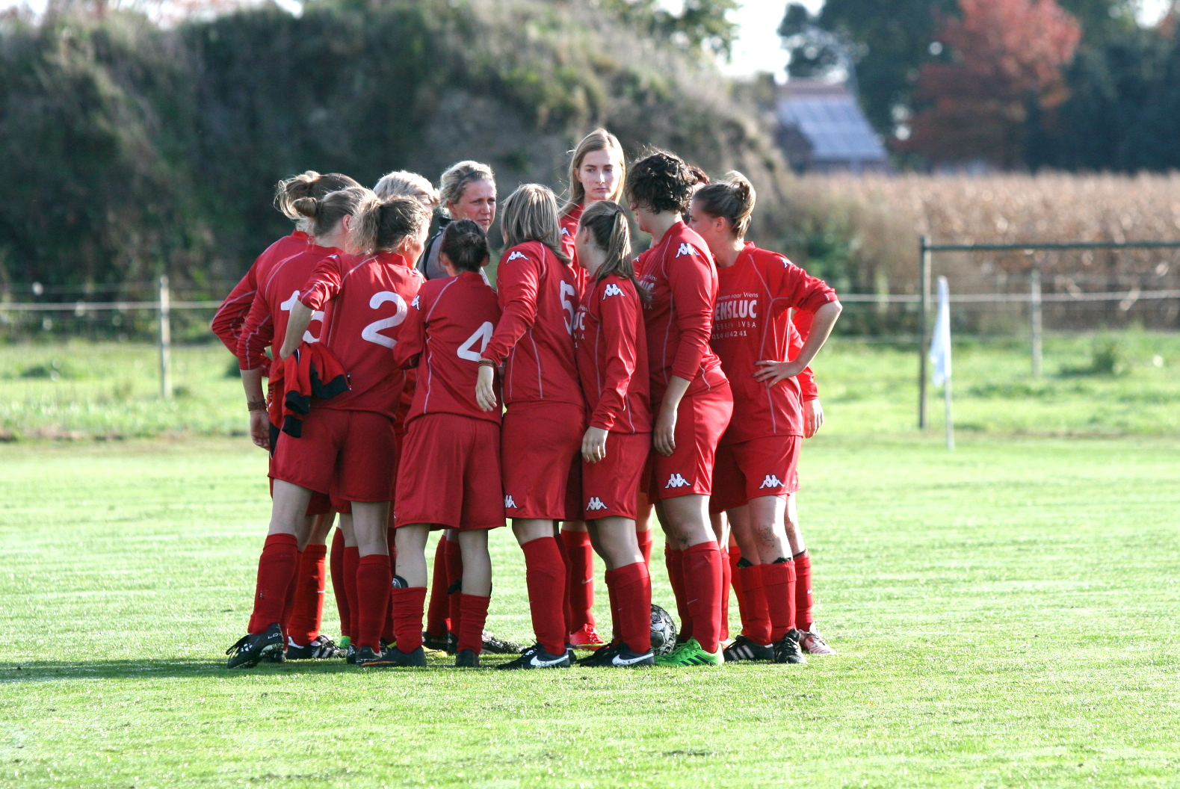
Story of a mentor
Notes:
Bij ons in de werking wordt bij het maken van afspraken over de grenzen dikwijls de metafoor van een
voetbalveld gebruikt: ‘Jullie krijgen een groot plein, kunnen rondlopen, kunnen doelpunten scoren maar
als je over de witte lijn gaat, krijg je een strafpunt.

Slide 20
HOW?
Concretize
Positive formulation
Less is more
Notes:
How can you create a well-defined framework?
Concretize:
Positive formulation: describe the desired behavior, do not focus on the inappropriate behavior
Less is more: limits on number of lines
Concretiseer: jongeren hebben het moeilijk met abstracte begrippen -> beter vertalen naar tastbare situaties
Positief formuleren: meer motiverend om het gewenste gedrag te beschrijven en niet te focussen om het ongewenst gedrag
Minder is meer: beperk het aantal regels = veel krachtiger

Slide 21
To cope with reward and punishment
Giving young people responsibilities
If they don’t: consequenses
Notes:
To cope with reward and punishment
Giving young people responsibilities:
For example: go to school on time
If thye don’t: consequenses
For example: they get a not

Slide 22
How to reward and punish
Reward | Punish
Words | Ignore
Material and physical | Words
Extra fun activity | Denying something fun
 | Sanction
 | Time out
Notes:
Reward: Punish:
words: well done;. - Ignore: some ask attention on the wrong way, give attention to positive behavior: take bad beh away
Material and physical: candy - words: warning
Extra fun activity: works motivating - denying something fun
Sanction
Time out
Belonen:
woorden: schouderklopje/complimentje
Materieel: lekkers/kleine attentie -> spaarzaam mee omgaan
Extra leuke activiteit: werkt motiverend
Punish:
negeren: sommige jongeren vragen aandacht op de verkeerde manier en aandacht tonen voor positief gedrag kan het storende gedrag vanzelf afnemen
Woorden: waarschuwing geven
Iets leuks afnemen: materieel of verbieden leuke activiteit
sanctioneren/ herstellende activiteit
Time out

Slide 23
Training offer
Combination of:
Formations
Individual moments
Conversations (individual or in group)
Group- oriented activities
-> abilities + confidence + realistic self-image
Notes:
So young people can experience what their abilities are
plus they win confidence and develop a realistic self-image

Slide 24
Activities in group
Active approach
- atelier operation
- workshop
- sports activities
- training courses
- cultural activities
Examples: trust game, evaluate each other in group, looking for information,…
Notes:
personal development process:
POT: actieve werkvormen
- atelierwerking, -workshop, -cursussen, -culturele activiteiten, -sportactiviteiten

Slide 25
Individual activities
Different ways
Same command
Individual command
Different interesse: customized activitie
Notes:
Individuele activiteiten worden enkel binnen pot aangeboden
Ze kunnen verschillende vormen aannemen
Allemaal aan dezelfde opdracht werken, maar ieder werkt op zijn eigen tempo
Jongeren werken echt aan een individuele opdracht
Als een jongere interesse heeft maar dit niet wordt aangeboden binnen pot, dan gaan ze op zoek naar een maatgerichte invulling

Slide 26
Conversations
Individual / in group
Formal / informal

Slide 27
Formal
Individual
Same time, same place
Attention to the welfare of the younger
Viewing the evolutions, the successess and the working points
Evaluation form
Portfolio
Weekly schedule
Notes:
Pot:
gesprekken op vaste tijd en vaste moment in het traject
Aandacht voor welzijn jongeren vb; druggebruik, psychologische problemen
Bekijken van de evoluties, de successen en de werkpunten
Evaluatieformulier, portfolio, weekschema gebruiken om sterke en werkpunten te bespreken

Slide 28
Formal
Network
Same time
Case consultation
Different partners
Evolution
To involve the yougster
Notes:
Binnen POT op vaste tijdstippen case-overleggen:
Verschillende betrokken partners rond tafel evolutie jongere bespreken, jongere zelf zoveel mogelijk betrokken
Binnen VT communiceert school met netwerk
Geen formele overlegmomenten, enkel in crisissituatie

Slide 29
Formal
In group
Work points
Conflicts
To reflect
Notes:
Werkpunten bespreken
Conflicten uitklaren
Reflecteren op activiteiten

Slide 30
Informal
Group / individual
Trust
Notes:
Groep / individueel
Belangrijk ontwikkelen vertrouwensband

Slide 31
Working together
Strong team
Work with network youngster
Work with network organisation
Notes:
Belang van een sterk team
Samenwerken met netwerk jongere
Samenwerken met netwerk van de organisatie

Slide 32
Importance strong team
Good contact
Trust
Structure
Agree about discissions
Be aware of the situation
New employees
-> feeling safe and secure
Notes:
Om te werken aan een goed contact en een vertrouwensband met de jongere en om hen een duidelijke structuur mee te geven is een goed op elkaar afgestemd team zowel binnen pot als vt enorm belangrijk.
Hele team achter beslissingen en afspraken staat + op hoogt wat er zich in leven jongere afspeelt.
Hechte band= ook belang voor nieuwe medewerkers terecht om moeilijke momenten te bespreken.
Jongeren een veilig en geborgen gevoel.

Slide 33
Work with network youngster
Parents
To involve (+ - )
Home visits: gender sensitivity
Friends
Peer influence: tool for information
Professionals
School
Police
Juvenile court
Notes:
Ouders
Betrokken: traject positief als minder gaat
Huisbezoeken: bewust zijn van gendergevoeligheid bij bepaalde gezinnen Vb. vrouwelijke begeleidster gezag allochtone vader. (a female mentor does not affect an immigrant father)
2) Vrienden
Peer influence, hulpmiddel bij activiteit vrienden uitnodigen zo info krijgen
3) Professionelen betrekken
Spijbelpolitie, jeugdrechtbank, school

Slide 34
Work with network organisation
A well- developed partnership makes it easyer to refer te youngster in both directions
More options tailored to the needs of the youngster
Notes:
a well-developed partnership facilitated by references in both directions-more features with custom of the younger

Slide 35
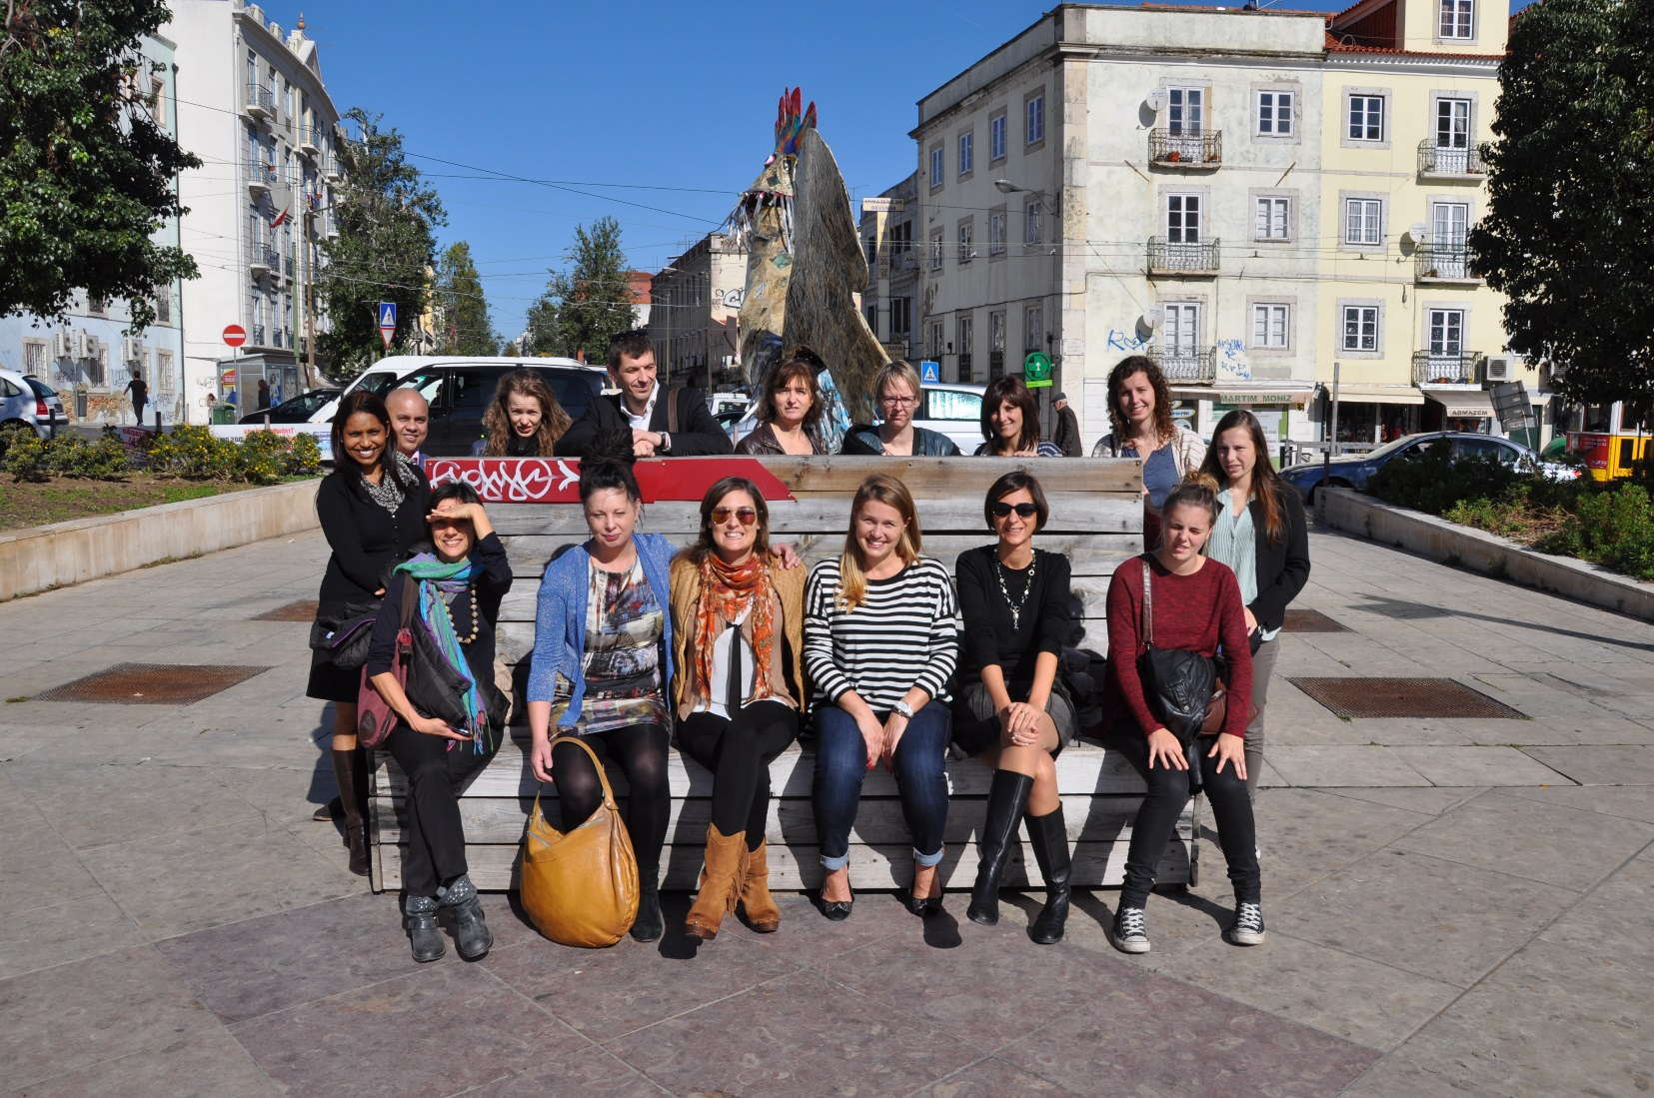
But…
Notes:
But such partnership is only possible if the organizations are aware of each other's effect. Thereupon it is important to create a common basis, a shared vision to the young people with the intention of the effect of the actions taken by the organizations involved on our young people. Finally, the development of this close partnership is a constant process.

